Slide 1

First Look at Fabric
- From a PowerBI Capacity Admin
- I try to be neutral, but I am biased because I want fabric to be successful.
It is just some personal observations not Facts ( OneLake and Egress fees, Spark and the option to customize)
It is still in Preview, Not Production ready , good for POC at this stage
Make your Feedback clear
Fabric Product Team do listen, especially now ☺ The PM want people to use it.

Slide 2
Bio
Mimoune Djouallah (mim)
PowerBI developer. ( Ex Construction Planner)
https://datamonkeysite.com/ (blogs about PowerBI, BigQuery, Fabric, Oracle Primavera and a bit of Looker Studio & Construction)
nemtracker.github.io : Dashboard to Track Australia Electricity Market
Twitter @mim_djo
Linkedin : https://www.linkedin.com/in/mimounedjouallah/
Link to the presentation Files

Slide 3
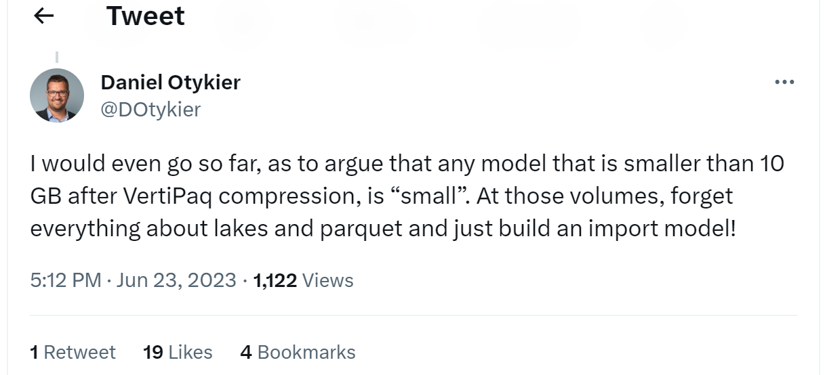
Nothing changed for PowerBI, it is just more options
If you have *Medium* data that don’t refresh frequently, Import Mode is perfect

Slide 4
Why Fabric ?
Companies make decisions based on a context

Slide 5
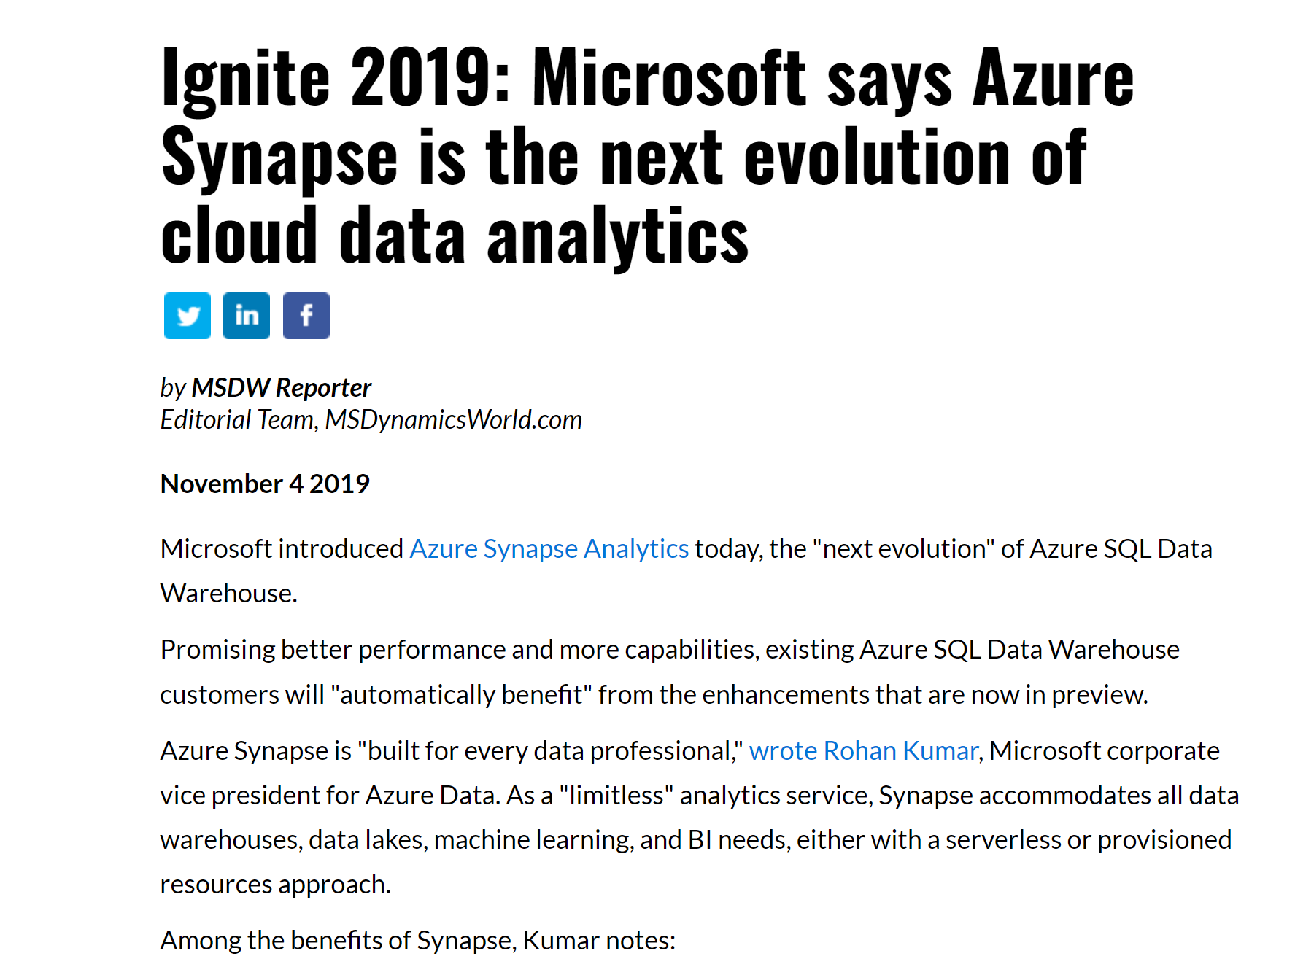
Historical Context

Slide 6
Synapse Gen3 was not good enough and was not delivered

Slide 7
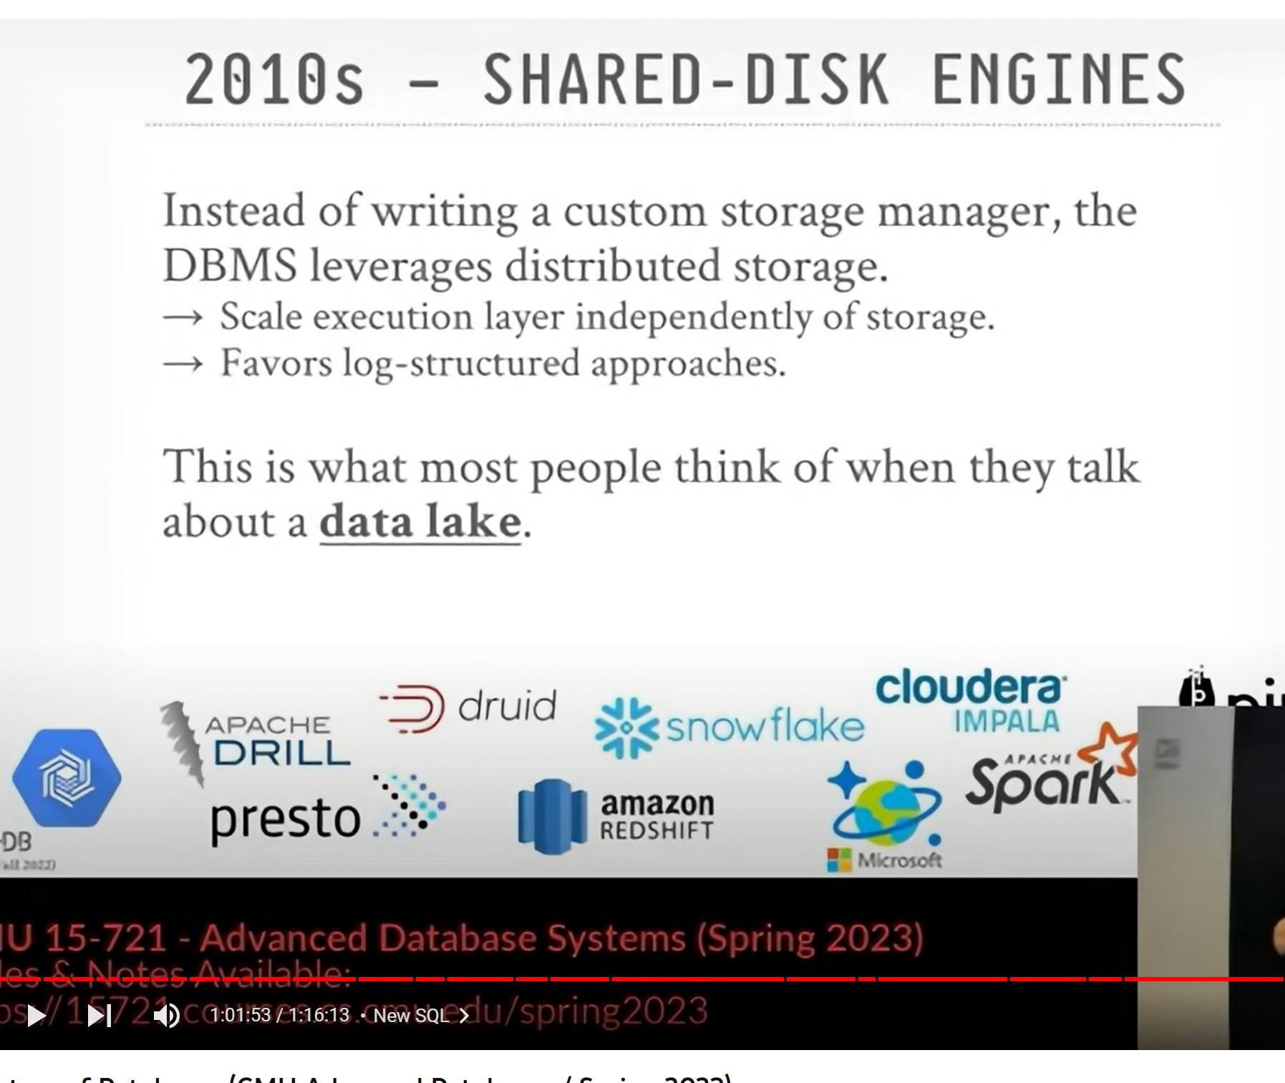
Separation of Storage and Compute

Slide 8

PowerBI Everywhere
- One of the Best Software invented beside Excel

Slide 9
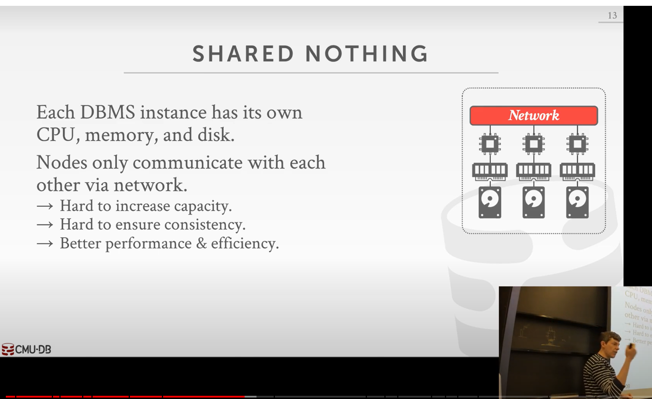
PowerBI Team took Over Synapse
Synapse Engines don’t talk to each Other
Synapse serverless don’t write Data
Dedicated Pool has the weird concept of Distribution, and is Basically a shared nothing architecture, Storage is basically coupled with Compute

Slide 10
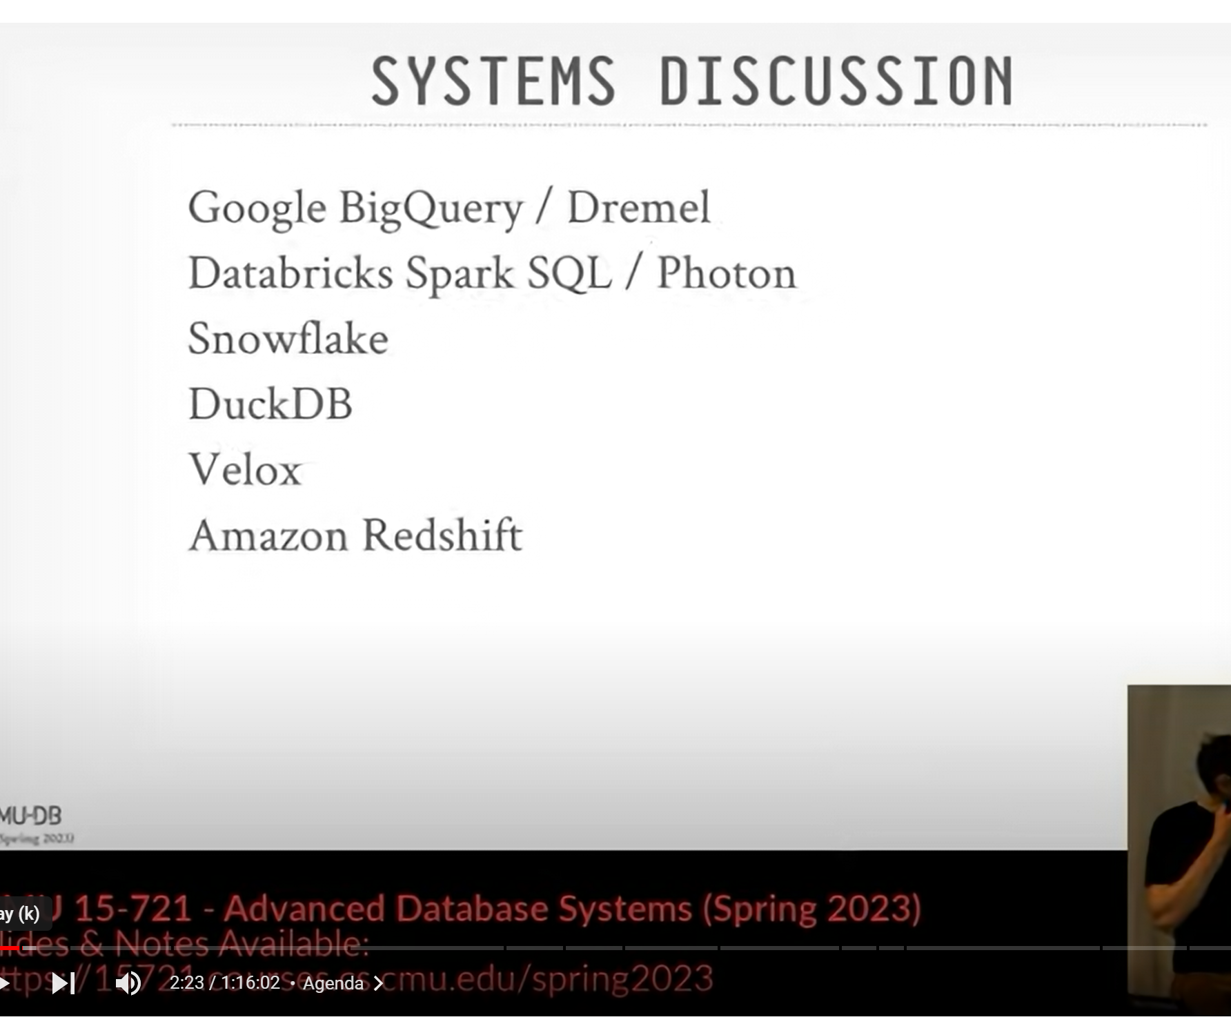
Whatever you think : Microsoft is not driving innovation in the Data Cloud space

Slide 11
There is Obviously a Problem

Slide 12

Fabric Core design decisions
- Merge Synapse and PowerBI Team Under the same Organization
Use Parquet as a File Format for Fabric DWH, That’s a very Bold Risky technical decision
Fabric Bursting

Slide 13
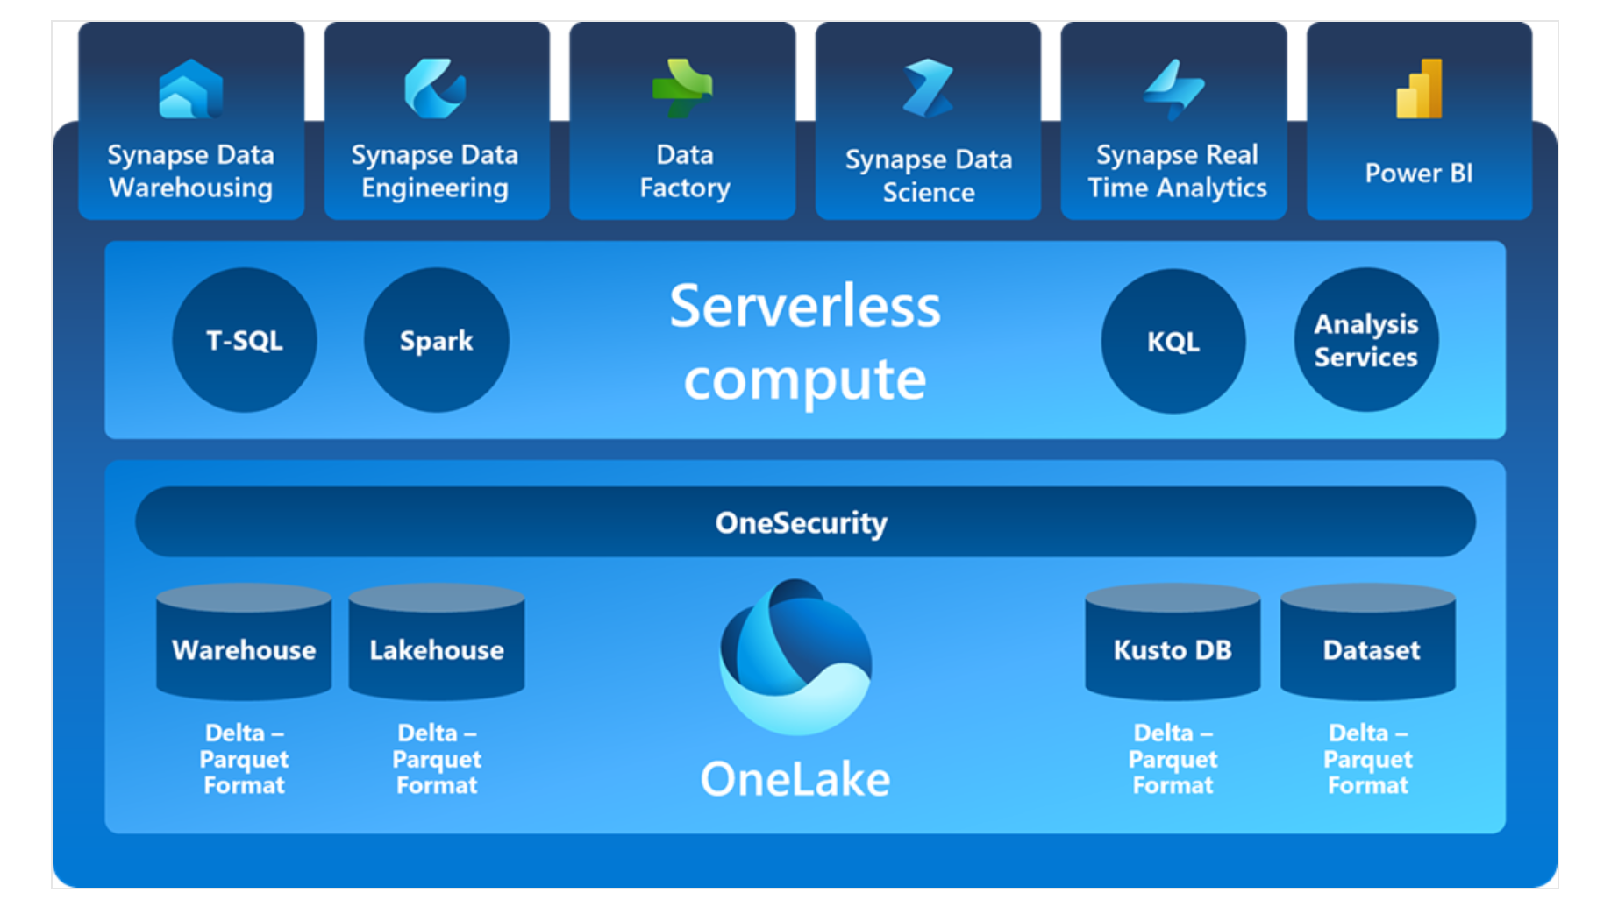
Fabric Architecture
Standard Storage Layer Using Delta Table
Multiple Engines ( too many maybe)
OneSecurity not available yet (LH access at WS level)
PowerBI Direct Lake
Two Writing Path
SQL for managed Table
Any tool can write to the LH (Only Spark supported officially)
They may add more Engines !!!

Slide 14
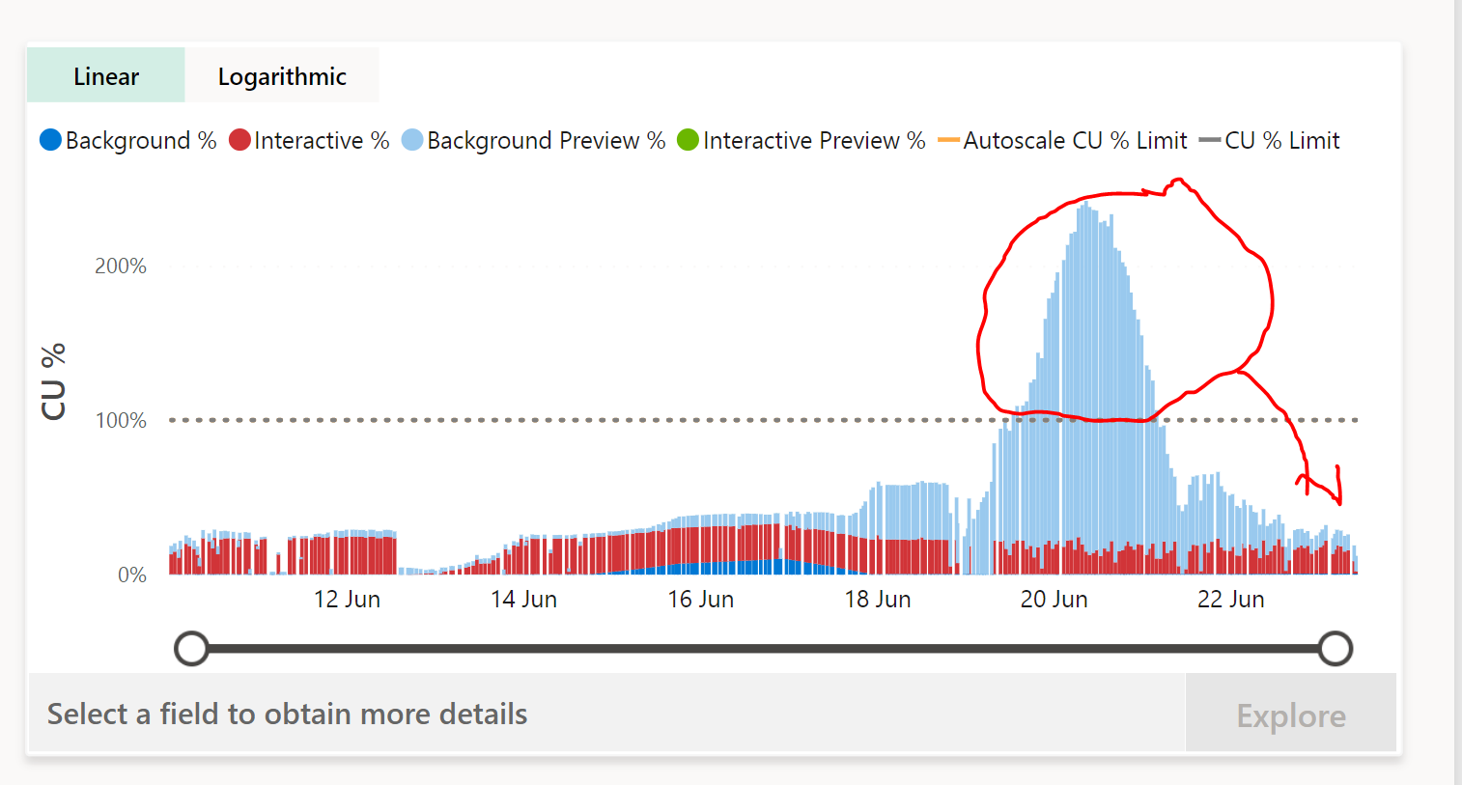
Fabric Bursting
Use Now Pay later
Use more resources to get the Task done then smooth it on a time period
Not sure how this Model will work for pay as you go model, do you get charged more if you suspend your capacity before paying back your extra charge

Slide 15
License This may change
Capacity Only, no luck for PRO and PPU
P SKU : The best option, 1 Bill Guaranty
F SKU pay as you go : you can suspend and resume but …
No Real Automation ( not obvious how to capture PBI Workload)
You may pay for Bursting if you try to be very clever about it
F SKU Reserve Instance: This is what Microsoft want to you to buy
- Bill for Storage
- Bill for Egress fees
- Bill for storage transactions
- Bill for any extra service that they may want to release.

Slide 16
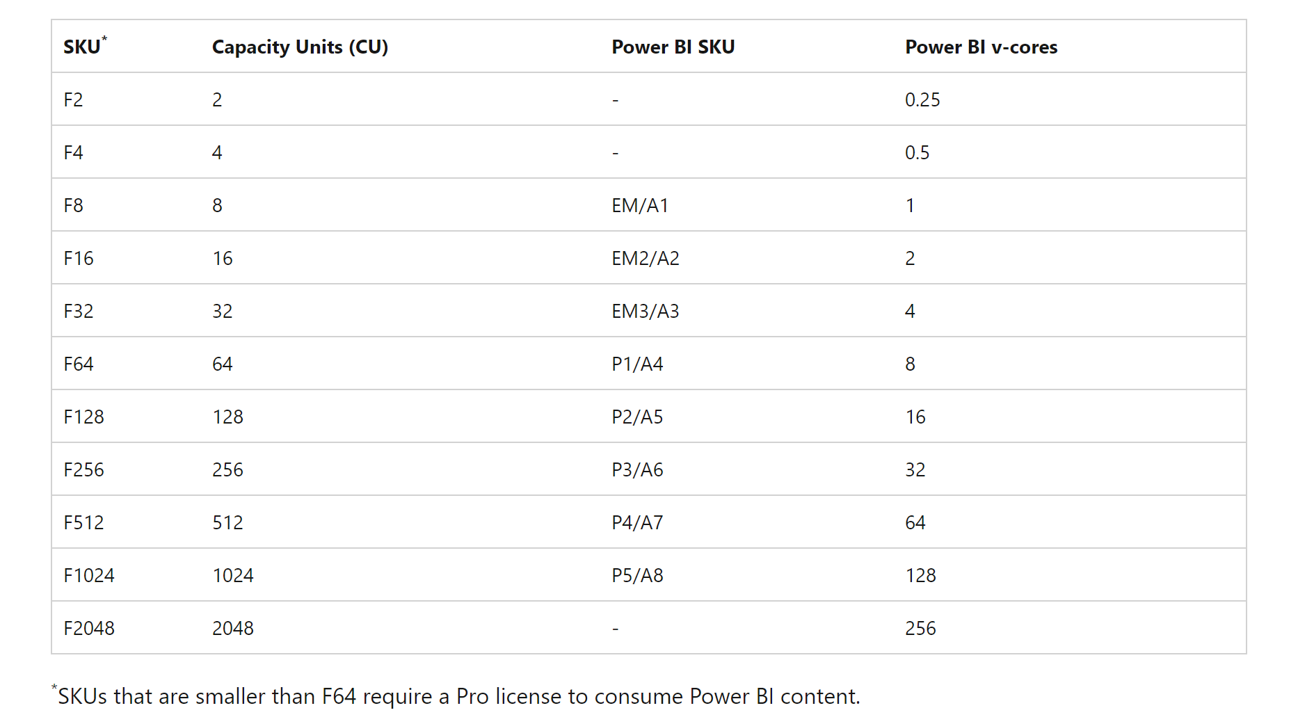
64 is the magic number
F64 IMHO is a different product category, and it is pretty much unique in the industry
Wishful Thinking, Microsoft can lower the bar anytime, maybe in a couple of years Free PowerBI reader will start with F32 ☺☺☺

Slide 17
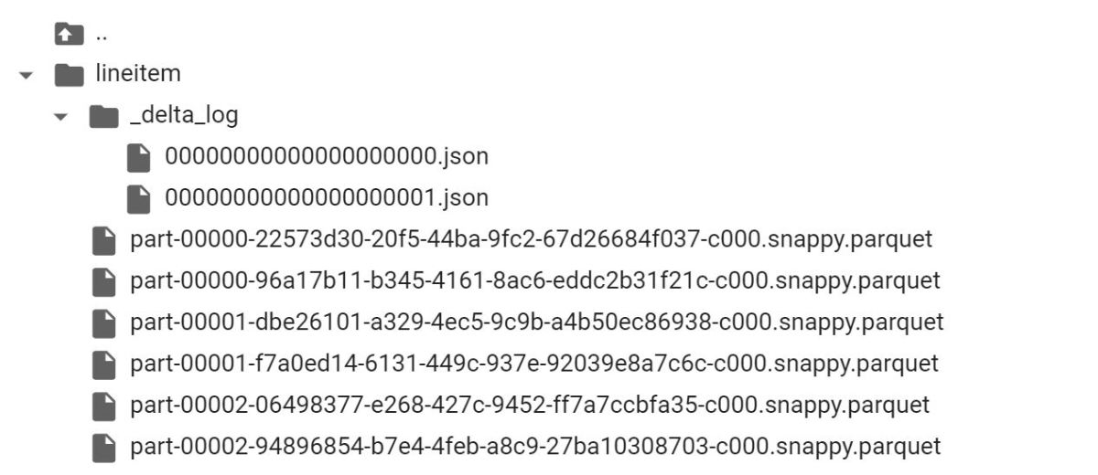
Delta Table
There are multiple Table storage format, some open source Like, Delta, Iceberg and Hudi
Proprietary Format like Snowflake PAX and BigQuery Capacitor
Object Store ( Like S3, GCP and Azure Storage, Cloudflare R2) are cheap but rather slow and immutable, you can delete and add basically, but you can’t alter an existing file.

Slide 18
Files in an Object Storage are immutable
Delete
Delete will Add files
Update
Update will add files
Append
Append will add files

Slide 19

The Small files Problem
Reading a lot of small files from a remote storage is very slow
Solution is to compact those files continuously
Maintaining Tables is not a fun exercise
Usually Cloud DWH (Snowflake, BigQuery) do it behind the scene on your behalf
Fabric DWH that behind the scene

Slide 20
Copy on Write vs Merge on read
The Previous behaviour is called Copy on Write; another approach is Merge of read
Instead of creating a new file, you just create a tiny file that shows only the rows that’s needs to be delete and you combine both at read time
That depends on the workload of course, but I like the copy on write, I am a BI dev, so read for me is more important.

Slide 21
Delta is Not Parquet
If you read the Parquet Directly without using the Log, you will get wrong results

Slide 22
Demo Delta Table Basic

Slide 23
Lakehouse vs Datawarehouse
Fabric has two types of Engine
Engine that reads the Data, PowerBI don’t care if the data was written using the DWH or Spark, or any tool for that matter ( although it works better with V-Order)
Engine that Write the Data, Spark (or others) or DWH SQL Engine

Slide 24
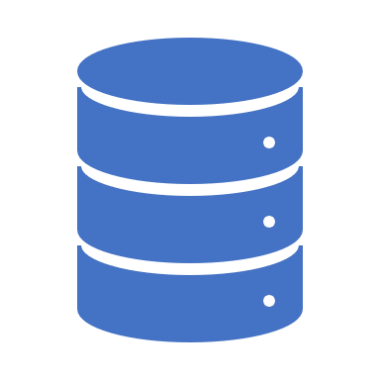
Managed vs Unmanaged Table
Both are Delta Table
DWH Table are written exclusively by the SQL Engine and are read Only outside of SQL Engine, vacuum, compaction etc is managed by Fabric
Lakehouse Table are read and write by anyone who has access to the Folder, concurrent write are guaranty only if you use Spark , Table maintenance is your problem
What to use ? That depends on your specific use case, pricing will be a big factor, but I suspect maybe both are useful
Whatever you choose, I think keeping raw data in a landing folder is a very good idea, after that, whatever make sense to you

Slide 25

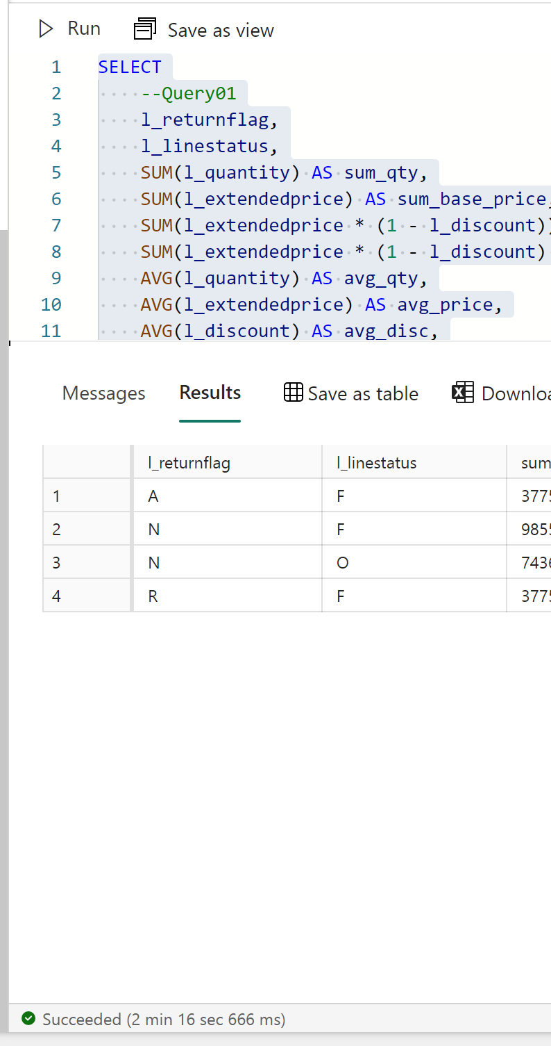
DWH Performance
At this stage we don’t much about the internal
Workspace seems to be a natural boundary
One SQL Endpoint by Workspace, No Global !!!
It is a distributed Engine, and it does not support result cache
First run from remote storage is rather slow, that’s expected.
Hot(or Warm) run are too fast ?
Number of cores ? Disk cache ?
But the user experience is spectacular

Slide 26
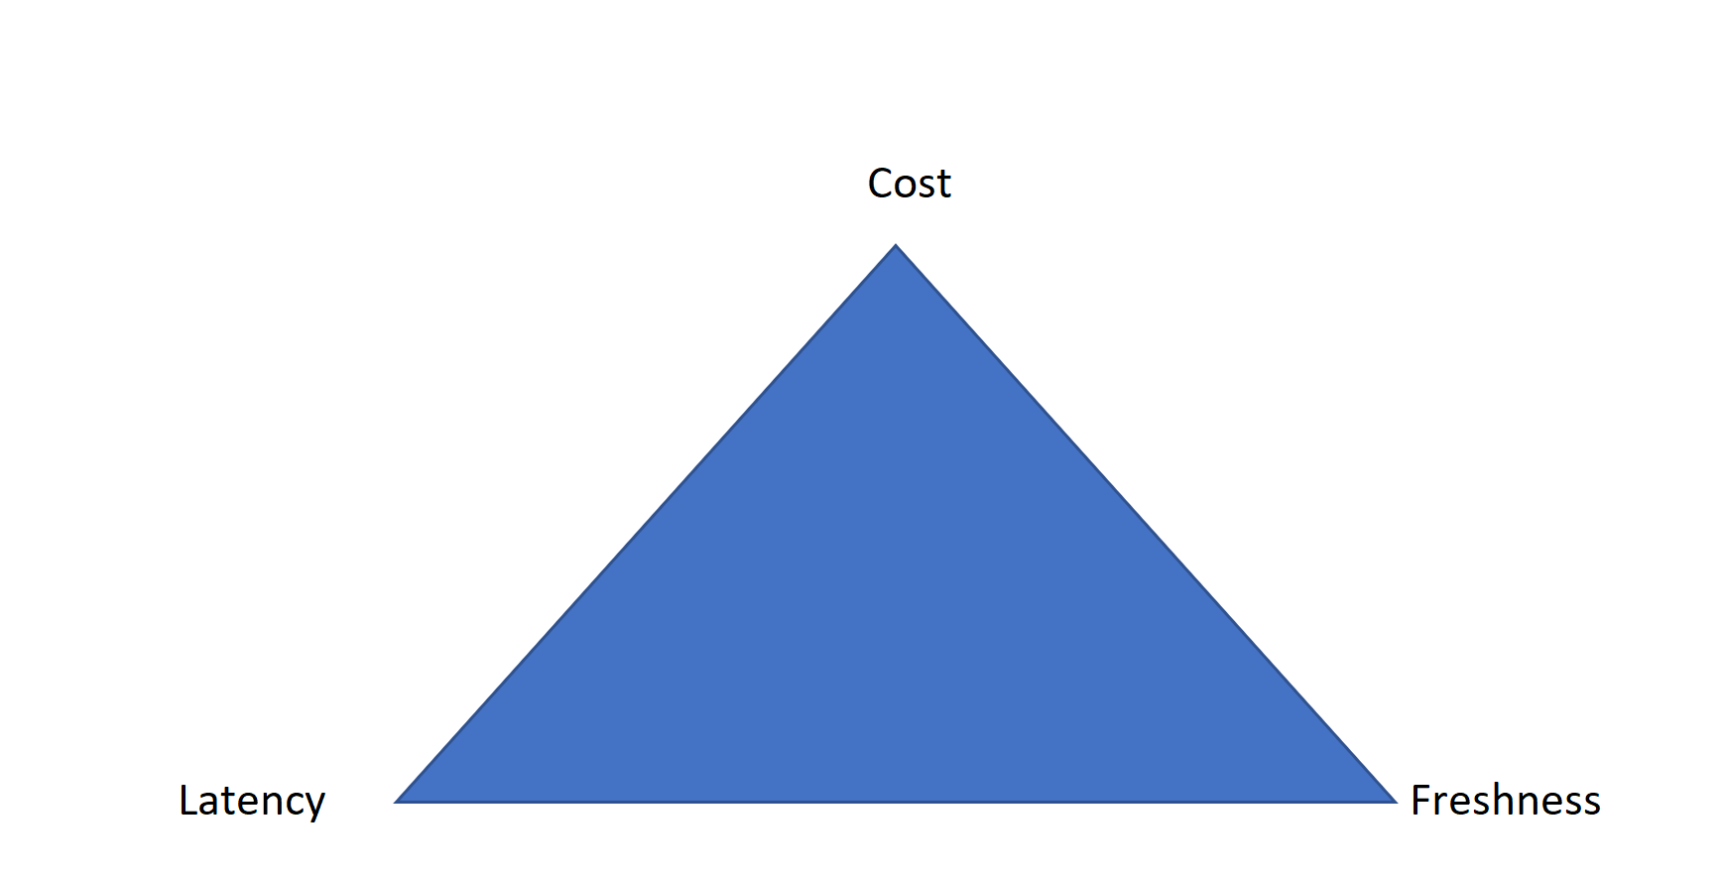
You can’t have it all

Slide 27
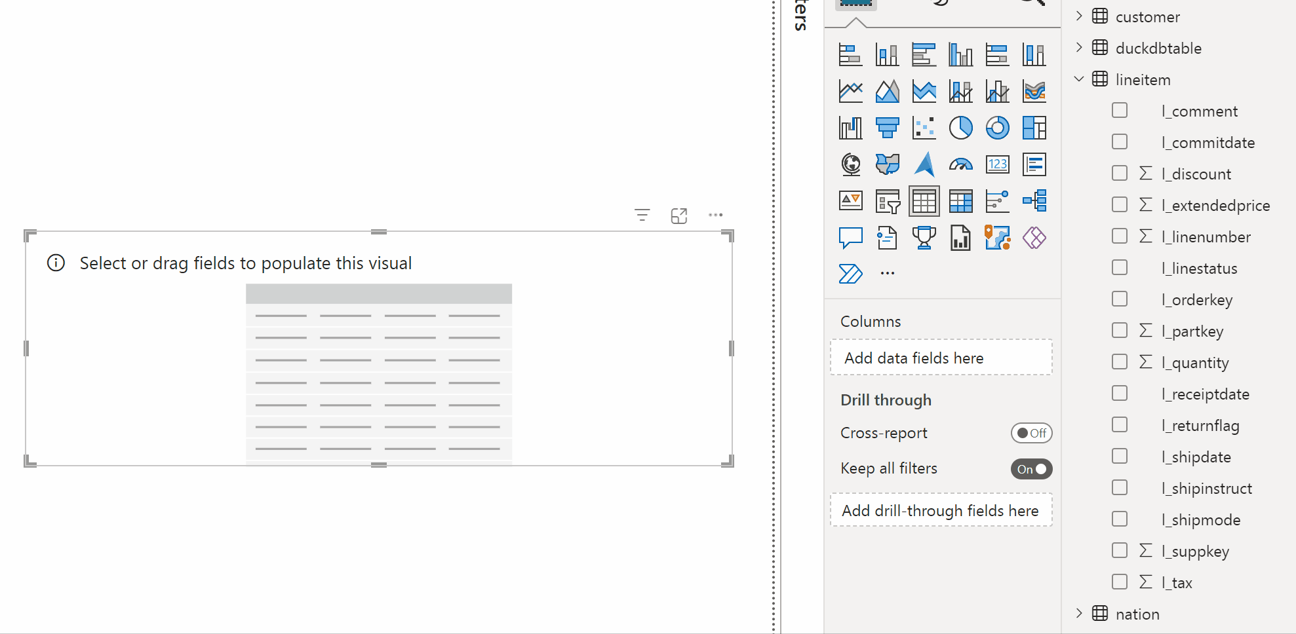
Demo Direct Lake

Slide 28
Direct lake
Vertipaq is still pure In-memory system, data has to fit in RAM
Higher SKU will give you more RAM
It is still Import but Directly to the memory
It is faster than import because the data was already compressed and sorted etc using V-Order
Can evict column not used in Queries
Fall back to DQ, I used BI Engine and BigQuery and I don’t like this fall-back mode, but because Fabric has a unified pricing model, it is not that bad after all

Slide 29

DEMO TIME

Slide 30
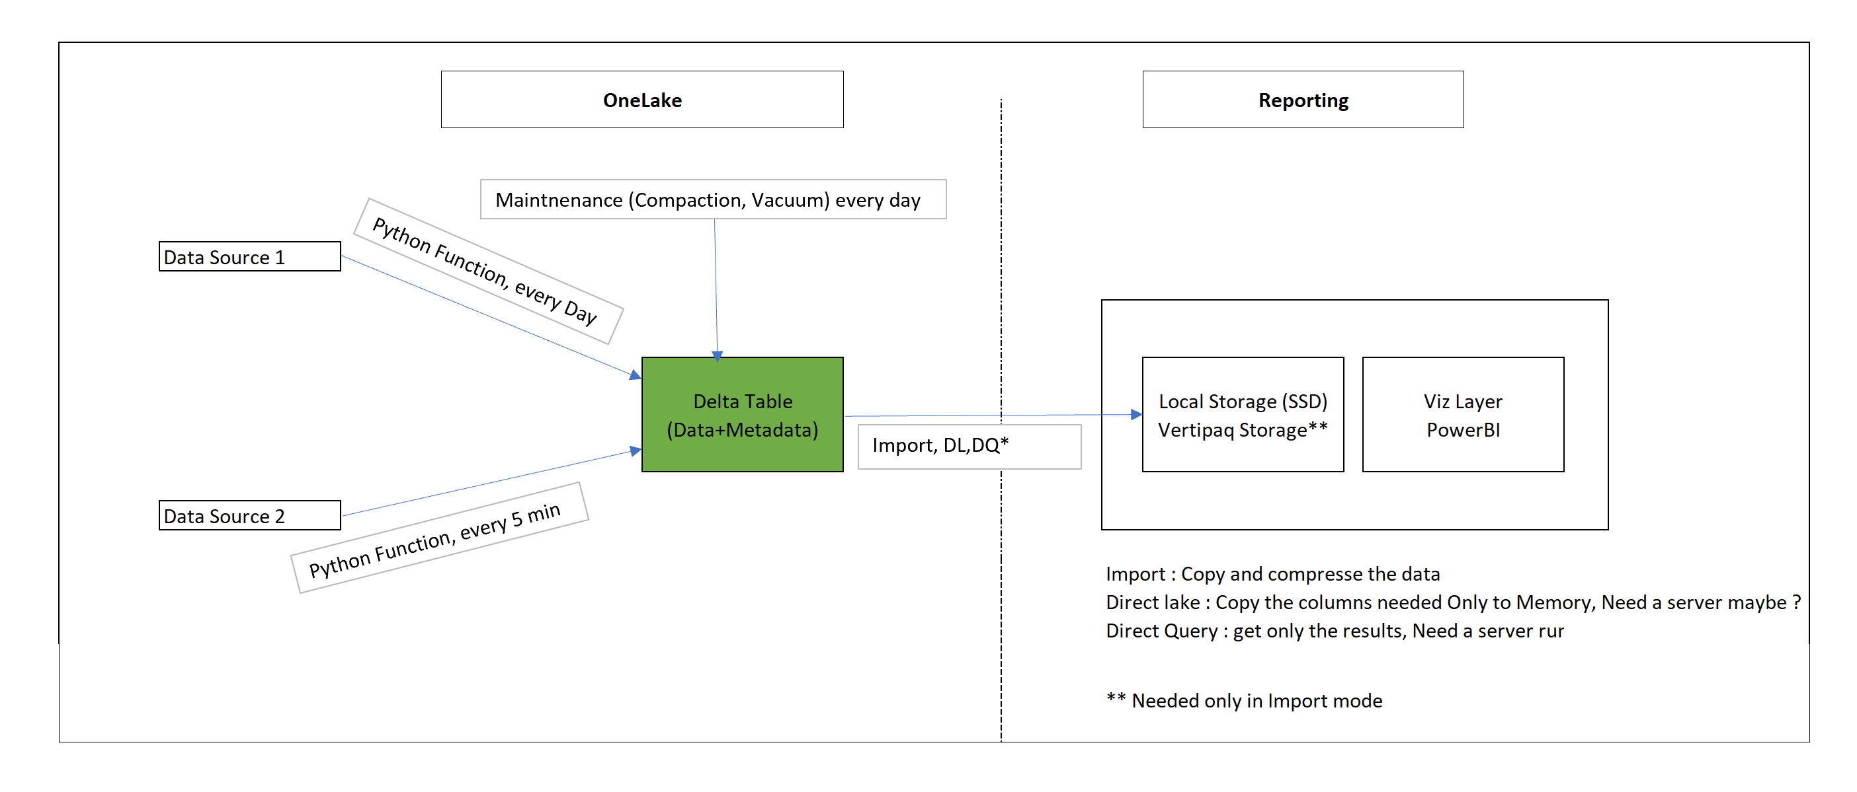
Demo Australian Electricity Data

Slide 31
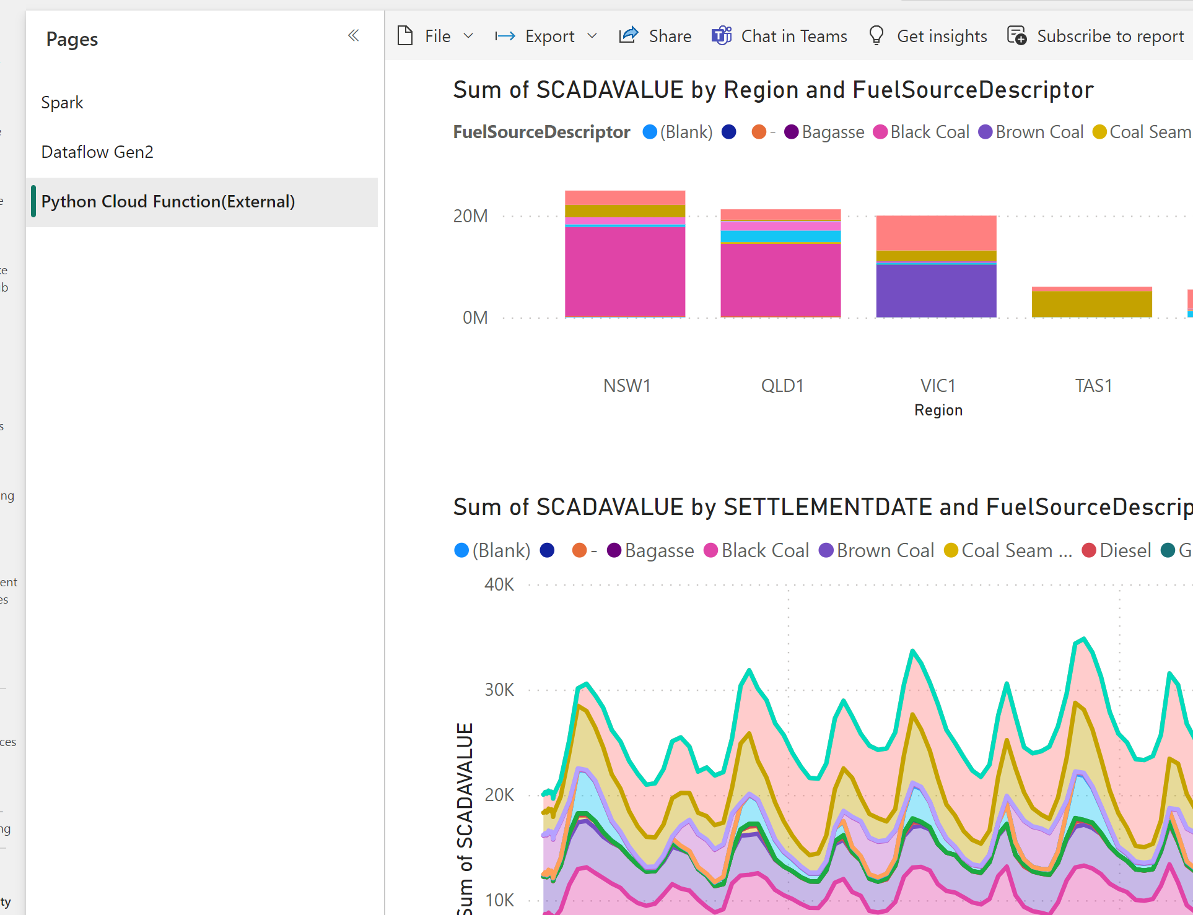
Demo Australian Electricity Price

Slide 32
Which option was the cheapest
I don’t know, the data is not available yet, Only Spark show usage

Slide 33
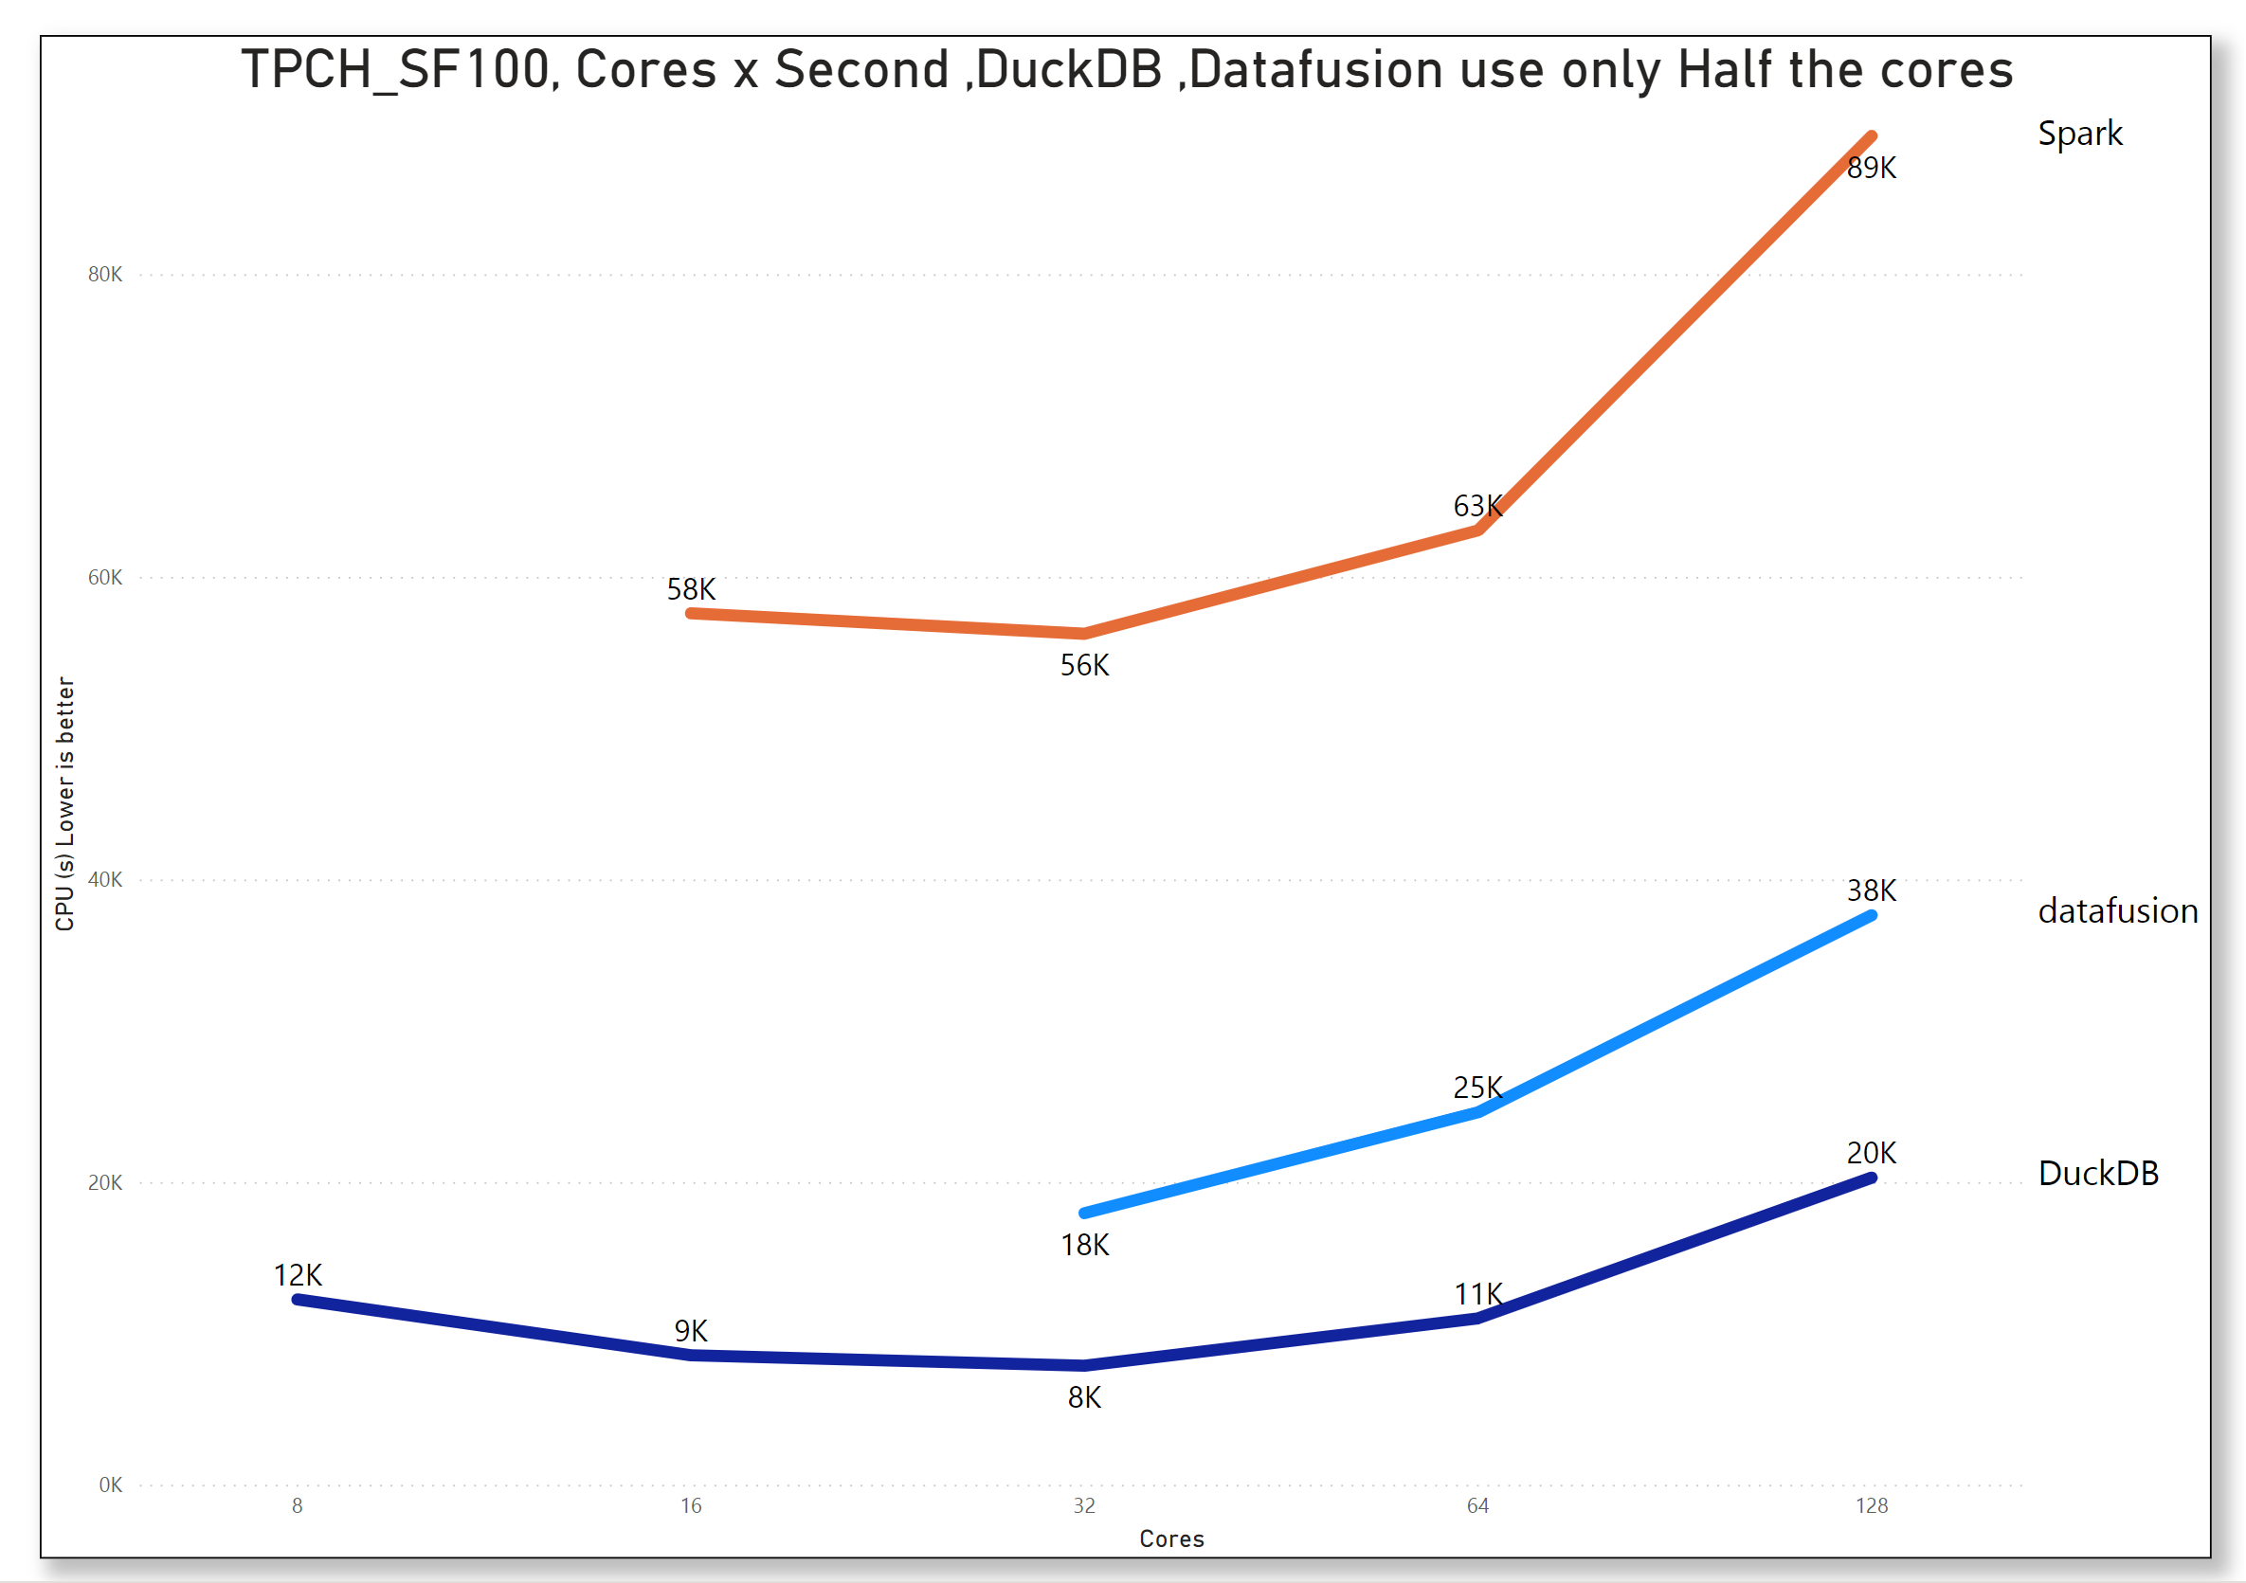
Spark is a Monster and Will eat your children

Slide 34
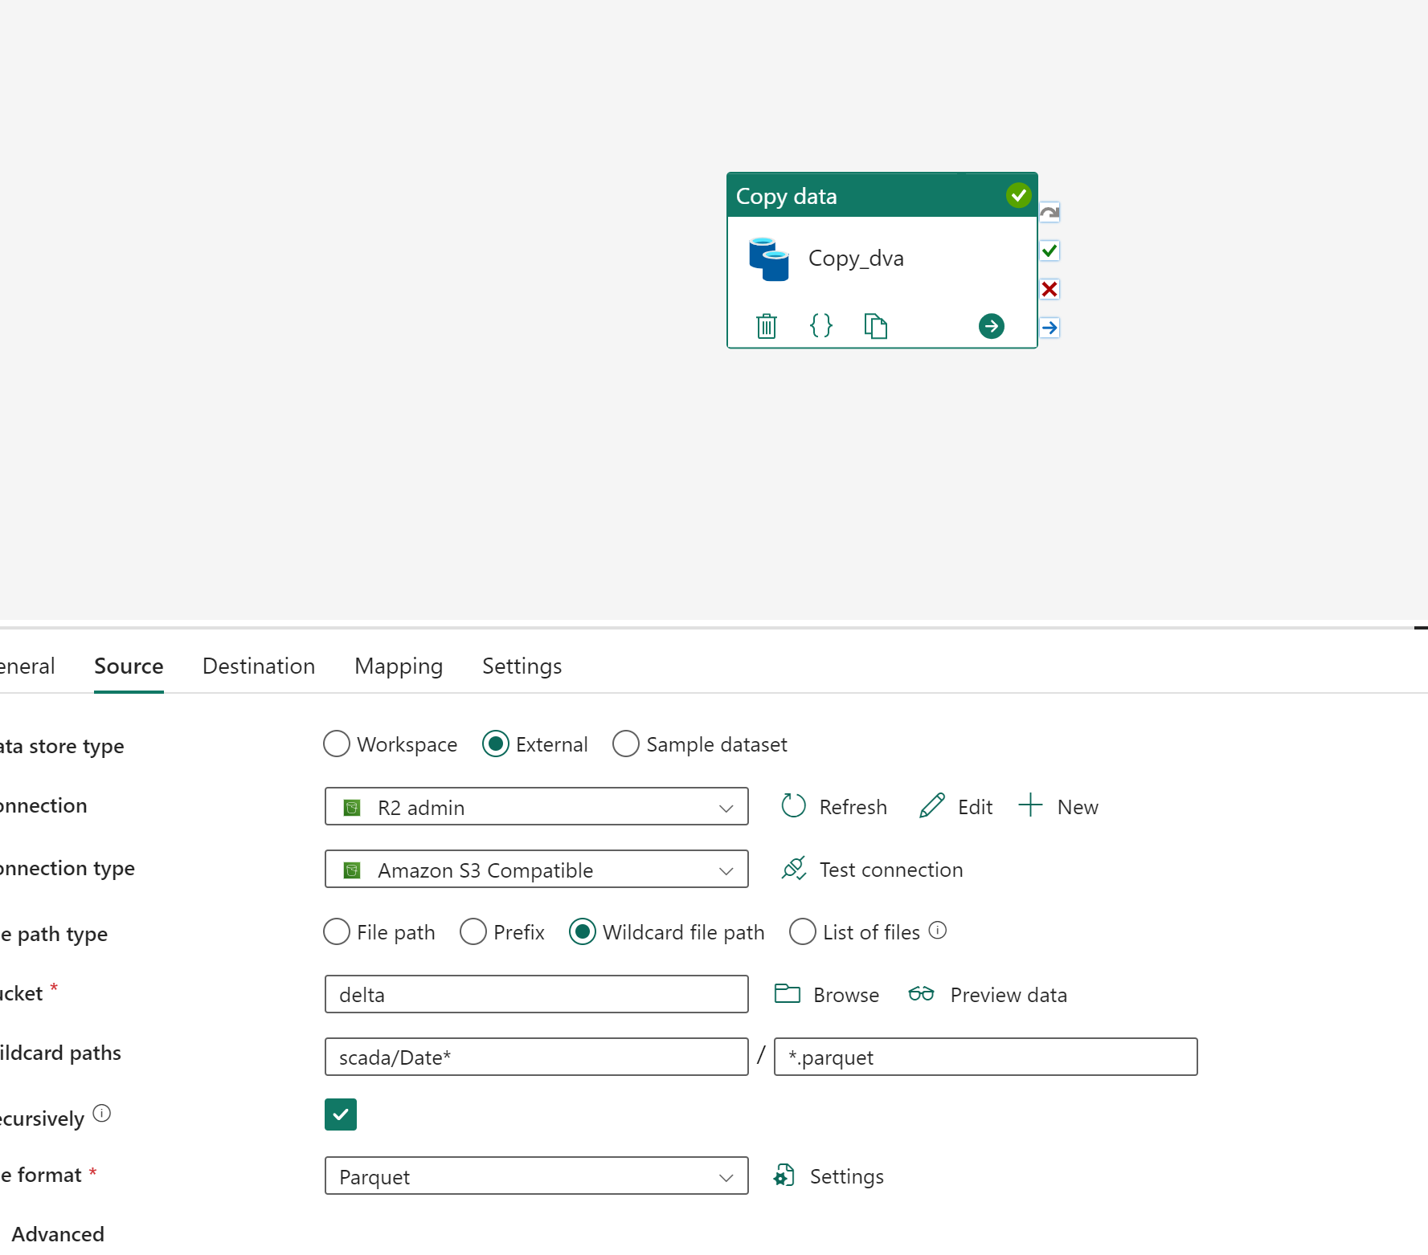
Demo Importing data to Fabric DWH

Slide 35
Nice to Have
The LH vs DWH is just a distraction, just merge the two and call it native table vs external table
Reduce Spark footprint in Fabric , Like in the LH UI
More investment in https://delta-io.github.io/delta-rs/python/
Single node Python experience.
Simplify the UI, hide or remove the default dataset if not needed

Slide 36
Workload isolation
It make sense to consolidate all capacity into one bucket so resources can be shared
But resource isolation is not obvious, maybe a separate capacity just for PowerBI still make sense

Slide 37
Final Thoughts
Don’t mess with The P SKU
Predictability is a great thing
But fabric is enjoyable , that matter a lot in adoption
PowerBI made semantic model a commodity, Fabric will do the same for Data warehouse

